Slide 1
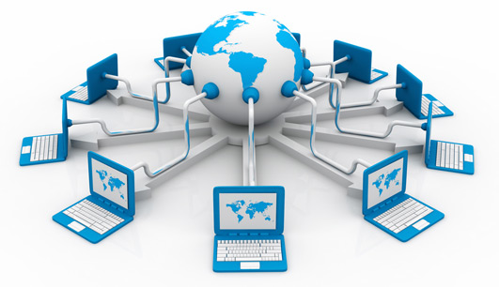
Introduction to Web Technology

Slide 2
What is Internet?
The Internet is a massive network of networks. It connects millions of computers together globally, forming a network in which any computer can communicate with any other computer as long as they are both connected to the Internet.
The Internet is simply a public access Wide Area Network, linking several million computers around the world. The Internet, or Information Superhighway, is the backbone which links together a huge range of information resources such as new services, corporate catalogues, bulletin boards and library archives, that can be delivered directly to the user’s desktop. As an example, an Internet user in Malaysia can log onto machines and servers in America or Australia, in order to browse and download information on millions of topics.
There are various ways that users can access this information, but the most popular and user friendly way is to use the World Wide Web. There are thousands of Web Servers on the Internet, each one presenting users with formatted ‘pages’ of text, sound and graphic based information. Using what is referred to as a Web browser, users can navigate this World Wide Web of linked information, using a ‘point and click’ windows based graphical user interface.

Slide 3
What is Intranet?
Rather than viewed as competition to the Internet, an Intranet can be viewed quite simply as a private internal company Internet.
If we think of the Internet as an open public service, an Intranet is an organization’s private version of it, i.e. information contained in a hypermedia based format, but only available to people within the organization rather than millions of users around the world.
When a company invests in an Intranet, its users have access to internal on­line data in a Web based environment. By using a browser a user can search through the contents of the company’s Intranet. This means that information becomes on-line, making it easier to distribute, update and obtain and replaces the need to distribute large amounts of paper

Slide 4
What is World Wide Web (www)?
The World Wide Web, or simply Web, is a way of accessing information over the medium of the Internet.
It is an information-sharing model that is built on top of the Internet.
The Web utilizes browsers, such as Internet Explorer or Firefox, to access Web documents called Web pages that are linked to each other via hyperlinks.
Web documents also contain graphics, sounds, text and video.

Slide 5
HTML, CSS & JavaScript
These are the three main building blocks of every website.
HTML
HTML is responsible for the structure of the site, CSS sets the styles, and interactive functionalities are implemented using JavaScript.
Every webpage is built on an HTML code. To check the HTML code of the current page press Ctrl + U and you will see a structured code using so-called tags to define the elements. We can specify what is a header, a link, a paragraph on our page using tags. To start learning HTML go to w3schools.com or experiment with the Online HTML Editor.
CSS
Thanks to CSS we can design nice-looking unique websites, setting colors, margins, borders, heights, font styles, background images etc. It's not necessary to use a stylesheet but without it every website would look the same, having black text on a white background, with blue links.
JavaScript
JavaScript is a program which is downloaded from the web server and runs on the client-side, which means that it's executed in the web browser. It is used to animate image galleries, to validate form fields before submission, to manage cookies, to bring dropdown menus to life etc.

Slide 6
What is Web Browser?
A Web browser is a program that allows you to interact and view the internet and contents of the Web.
The Web browser is the program you are using while browsing the Internet.
You just type in a URL (web link) in the address bar and the browser renders the website on your screen.
The most popular browsers are Google Chrome from Google, Firefox open source browser by Mozzilla, Safari from Apple, and Internet Explorer / Edge from Microsoft.
These have both PC and mobile versions.

Slide 7
What is Web Server?
A web server is a computer that runs websites. It's a computer program that distributes web pages as they are requisitioned.
The basic objective of the web server is to store, process and deliver web pages to the users. This intercommunication is done using Hypertext Transfer Protocol (HTTP). These web pages are mostly static content that includes HTML documents, images, style sheets, test etc. Apart from HTTP, a web server also supports SMTP (Simple Mail transfer Protocol) and FTP (File Transfer Protocol) protocol for emailing and for file transfer and storage.
You could set up your home computer to work as a web server but it's recommended to host websites on servers that are always running and are designed for this purpose having the required computing power, bandwidth, security, backup features and a helpful support team which can be accessed 24/7 if there's a problem with your website.
When you try to access a site you basically send a request to a web server to serve you with the content for that specific URL.

Slide 8
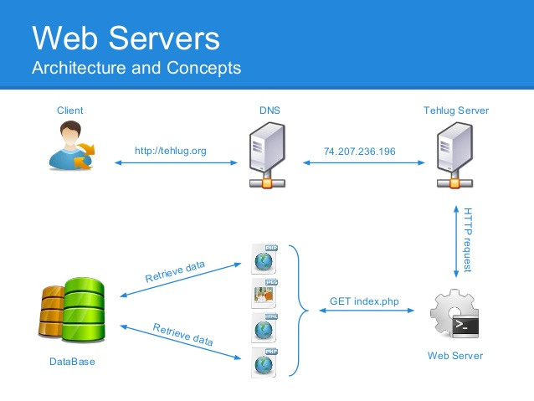
Web Server and Architecture

Slide 9
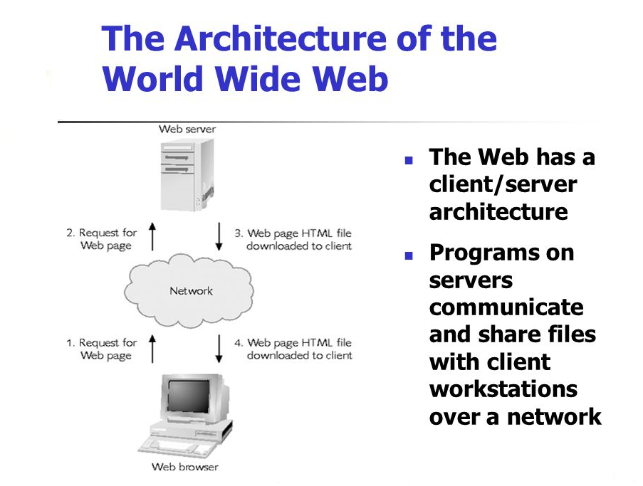

Slide 10
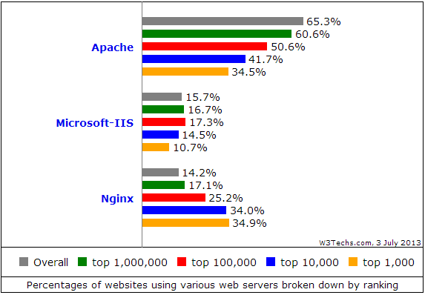
Popular Web servers

Slide 11
What is Domain Name?
Domain names are used to identify one or more IP addresses. For example, the domain name microsoft.com represents about a dozen IP addresses. Domain names are used in URLs to identify particular Web pages.
For example, in the URL http://www.google.com/index.html, the domain name is google.com.
Every domain name has a suffix that indicates which top level domain (TLD) it belongs to. There are only a limited number of such domains. For example:
gov - Government agencies
edu - Educational institutions
org - Organizations (nonprofit)
mil - Military
com - commercial business
net - Network organizations
ca - Canada
th – Thailand
Because the Internet is based on IP addresses, not domain names, every Web server requires a Domain Name System (DNS) server to translate domain names into IP addresses.

Slide 12
What is a URL?
Abbreviated as URL, a Uniform Resource Locator is a way of identifying the location of a file on the internet. They're what we use to open not only websites, but also to download images, videos, software programs, and other types of files that are hosted on a server.
Opening a local file on your computer is as simple as double-clicking it, but to open files on remote computers, like web servers, we must use URLs so that our web browser knows where to look.
For example, opening the HTM file that represents this page is done through the link at the top of the browser you're using.
Uniform Resource Locators are most commonly abbreviated as URLs but they're also called website addresses when they refer to URLs that use the HTTP or HTTPS protocol.
URL is usually pronounced with each letter spoken individually (i.e. u - r - l, not earl). It used to be an abbreviation for Universal Resource Locator before being changed to Uniform Resource Locator.
Examples of URLs
https://www.google.com
https://www.microsoft.com

Slide 13
What is HTTP?
Hypertext Transfer Protocol, HTTP is a set of standards that allow users of the World Wide Web to exchange information found on web pages.
When accessing any web page entering http:// in front of the address tells the browser to communicate over HTTP.
For example, the URL for Computer Hope is https://www.computerhope.com.
Today's browsers no longer require HTTP in front of the URL since it is the default method of communication.
However, it is kept in browsers because of the need to separate protocols such as FTP.
Below are a few of the major facts on HTTP.
The term HTTP was coined by Ted Nelson.
The standard port for HTTP connections is port 80.
HTTP/0.9 was the first version of the HTTP, and was introduced in 1991.
HTTP/1.0 is specified in RFC 1945, and was introduced in 1996.
HTTP/1.1 is specified in RFC 2616, and was officially released in January 1997.
.

Slide 14
What is HTTPS?
HTTPS
Short for Hypertext Transfer Protocol Secure, HTTPS is a protocol which uses HTTP on a connection encrypted by transport-layer security. HTTPS is used to protect transmitted data from eavesdropping. It is the default protocol for conducting financial transactions on the web, and can protect a website's users from censorship by a government or an ISP.
HTTPS uses port 443 to transfer its information.
HTTPS is first used in HTTP/1.1 and is defined in RFC 2616.
Tip: How to protect yourself and verify Internet data is secure while online.
HTTP status codes
404Below is a listing of HTTP status codes currently defined by Computer Hope. These codes enable a client accessing another computer or device over HTTP to know how to proceed or not proceed. For example, 404 tells the browser the request does not exist on the server.
.

Slide 15
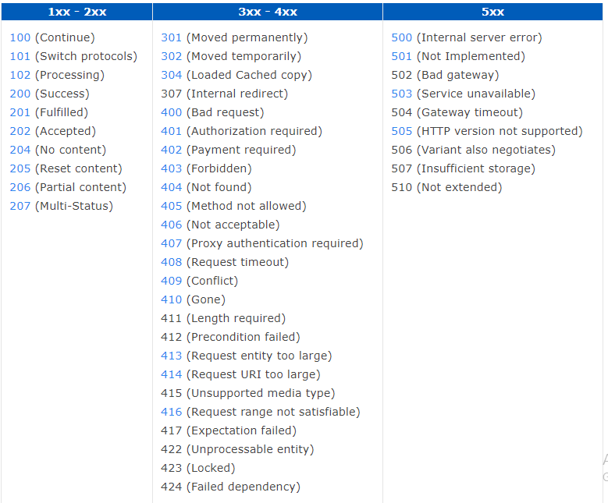
HTTP status codes

Slide 16
What is an IP Address?
An IP address, short for Internet Protocol address, is an identifying number for a piece of network hardware. Having an IP address allows a device to communicate with other devices over an IP-based network like the internet.’
Most IP addresses look like this:
151.101.65.121
What Is an IP Address Used For?
An IP address provides an identity to a networked device. Similar to a home or business address supplying that specific physical location with an identifiable address, devices on a network are differentiated from one another through IP addresses.
If I'm going to send a package to my friend in another country, I have to know the exact destination. It's not enough to just put a package with his name on it through the mail and expect it to reach him. I must instead attach a specific address to it, which you could do by looking it up in a phone book.
This same general process is used when sending data over the internet. However, instead of using a phone book to look up someone's name to find their physical address, your computer uses DNS servers to look up a hostname to find its IP address.
For example, when I enter a website like www.lifewire.com into my browser, my request to load that page is sent to DNS servers that look up that hostname (lifewire.com) to find its corresponding IP address (151.101.65.121).

Slide 17
Client And Server Side
We have to distinguish client and server side operations.
Server-side code runs on the server, using languages supported by the server (PHP, Java, C#).
Client-side programs runs on the client machine and are executed by the web browser (JavaScript).
For example the animation of a slideshow on a website is handled on the client side but when you try to log in to a website, your request is processed on the server side.

Slide 18
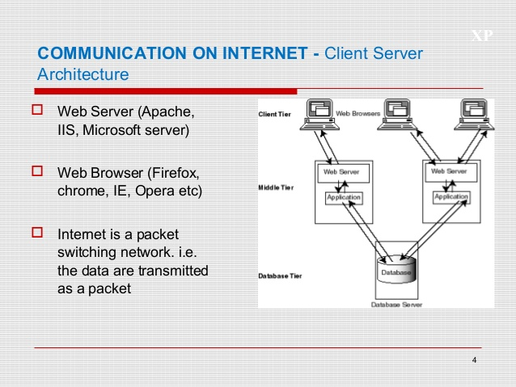
Client And Server Architecture

